Slide 1
Today’s application requirements
Pravin Y Pawar

Slide 2
Today’s application requirements
Digital experiences play a major part in many or most of the activities that we engage in on a daily basis
pushed the boundaries of expectations from the software :
want applications to be always available
be perpetually upgraded with new whizzbang features
provide personalized experiences
Fulfilling these expectations is something that must be addressed right from the beginning of the idea-to-production lifecycle
Key requirements:
Zero downtime
Shortened feedback cycles
Mobile and multi-device support
Connected devices—also known as the Internet of Things
Data-driven

Slide 3
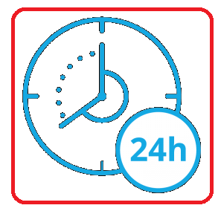
Zero downtime
One of the key requirements of the modern application: it must always be available
The world is working in "now mode"
Forgotten are the days when even short maintenance windows during which applications are unavailable are tolerated
Unplanned downtime has never been desirable, its impact has reached astounding levels
For example, long back Forbes estimated that Amazon lost almost $2 million during a 13-minute unplanned outage
Downtime, planned or not, results in significant revenue loss and customer dissatisfaction
no more just a problem only for the operations team
Software developers or architects are responsible for developing zero downtime software's!

Slide 4

Shortened feedback cycles
Another critical ability is to release code frequently
Required by significant competition and ever-increasing consumer expectations
Application releases are being made available to customers
several times a month
numerous times a week
even several times a day
The biggest driver for these continuous releases is the reduction of risk!
The best way to get mitigate the risk is to release an early version of a feature and get feedback
Using feedback, can make adjustments or even change direction entirely
Frequent software releases shorten feedback loops and reduce risk!
Source : facebook

Slide 5
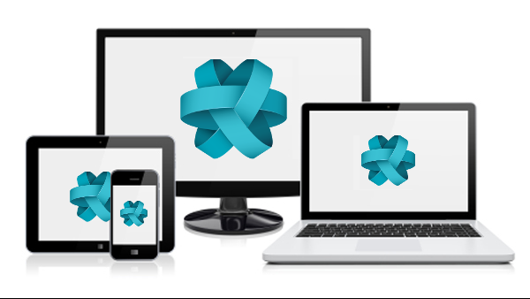
Mobile and multi-device support
Internet usage via mobile devices has already eclipsed that of desktop / laptop computers
Today’s applications need to support at least
two mobile device platforms, iOS and Android
as well as the desktop
Users increasingly expect to seamlessly move from one device to another as they navigate through the day with same app experience
For example,
Users may be watching a cricket match on an Android TV and then transition to viewing the program on a mobile device when they’re travelling
Designing applications the right way is essential to meeting these needs!
Source : savoirfairelinux

Slide 6
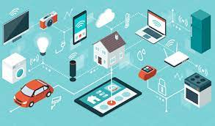
Connected devices
Internet of Things
The internet is no longer only for connecting humans to systems
Today, billions of devices are connected to the internet
Allowing devices to be monitored and even controlled by other connected entities
The home-automation market alone is estimated to be a $53 billion market by 2022
The connected home has sensors and remotely controlled devices such as
motion detectors
cameras
smart thermostats
lighting systems etc.
Other connected devices are automobiles, home appliances, farming equipment, jet engines, and the smartphone
Internet-connected devices change the nature of the software in two fundamental ways
the volume of data flowing over the internet is dramatically increased
the computing infra must be significantly different from those of the past, to capture and process this data
Difference in data volume and infrastructure architecture necessitates new software designs and practices.
Source : ThreatPost

Slide 7
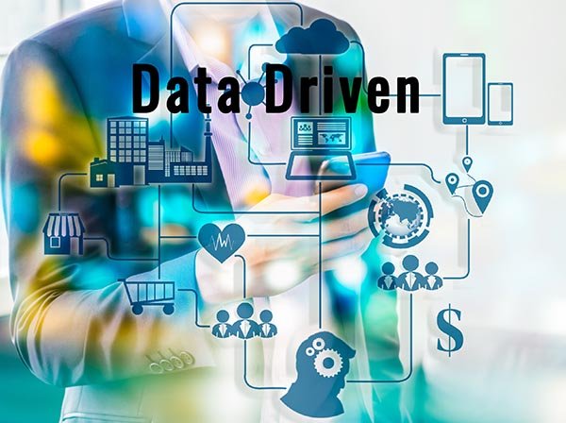
Data-driven
Volumes of data are increasing
Sources of data are becoming more widely distributed
These factors are affecting the large, centralized, shared database making them unusable
Instead of the single, shared database, application requirements
call for a network of smaller, localized databases,
software that manages data relationships across that collection of data management systems
New approaches drive the need for software development and management agility all the way through to the data tier.
All of the newly available data is wasted if it goes unused
Today’s applications must increasingly use data to provide greater value to the customer through smarter applications
Source : Dataversity

Slide 8
Thank You!
Reference:
Cloud Native Patterns by Cornelia Davis
In our next session:

